Slide 1
OpenCellular - Mechanics Assembly Document
History
Date | Version | Change Note No./Notes
19-01-2017 | 0.1 | Initial draft

Slide 2
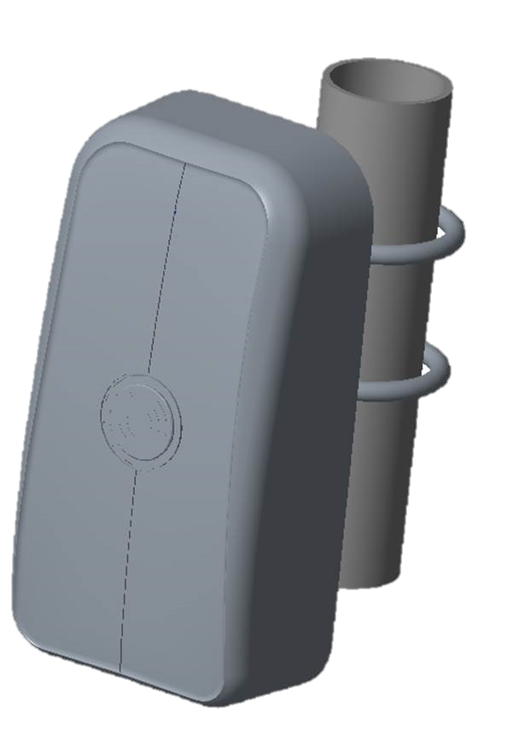
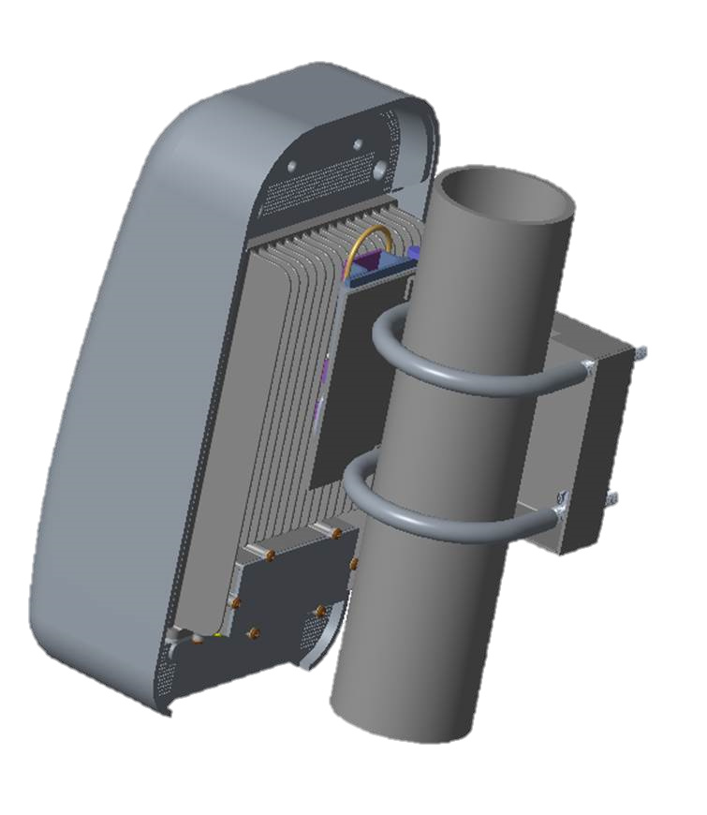
OpenCellular - Assembly

Slide 3
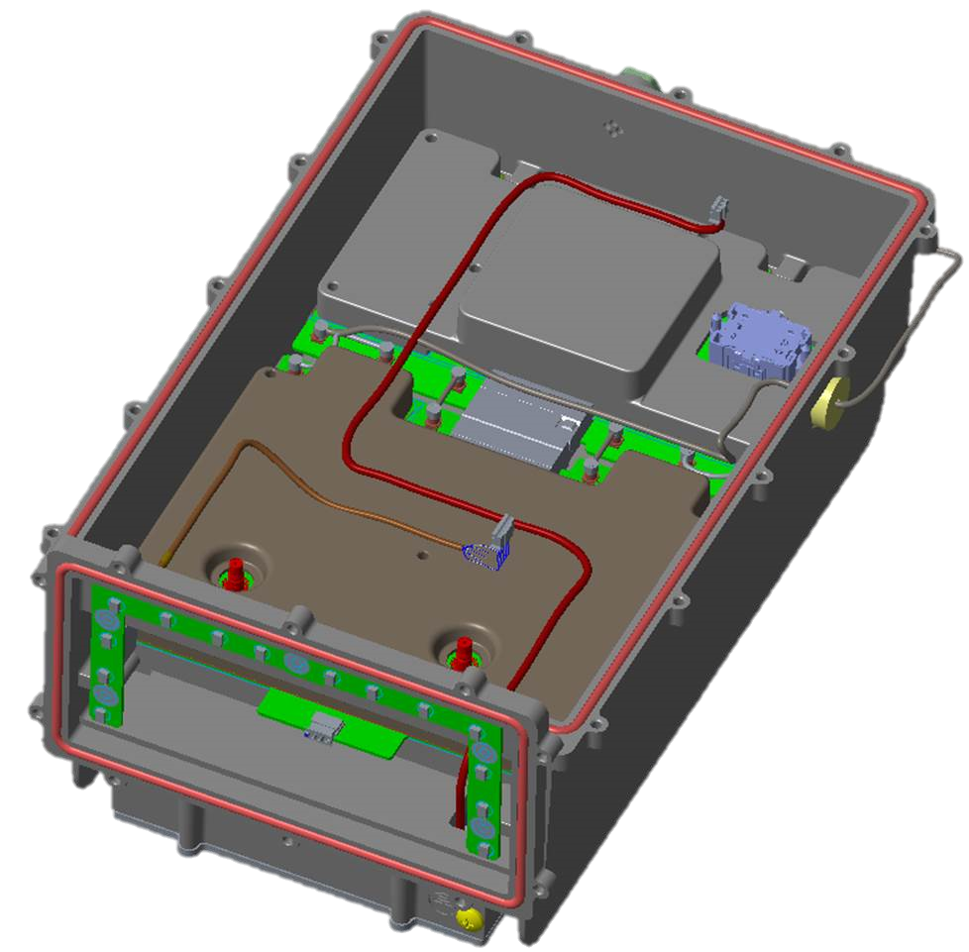
Main Chassis Sub Assembly
1.0

Slide 4
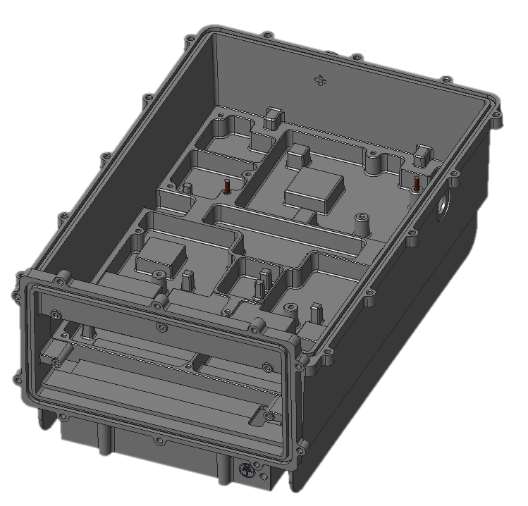
Main Chassis Sub Assembly
1.1
Guide Pin
Mechanics Chassis Sub Assembly Sequence
Sequence | Assembly steps | Type of Assembly
1.1 | Guide pin (FPQSA4-P3.00-L4-B10 2nos.) would be assembled by chassis manufacturing vendor | Pre – Assembly (Vendor Supplied)

Slide 5
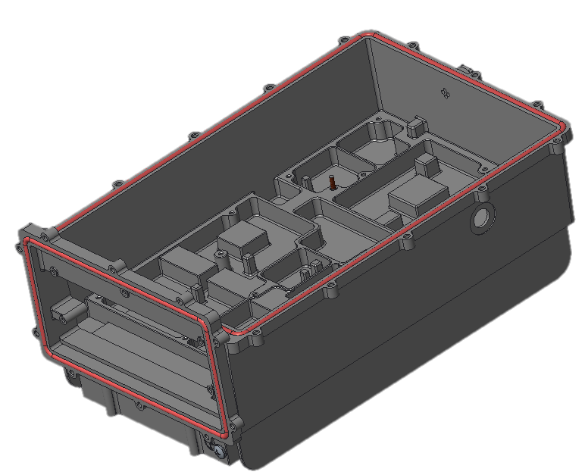
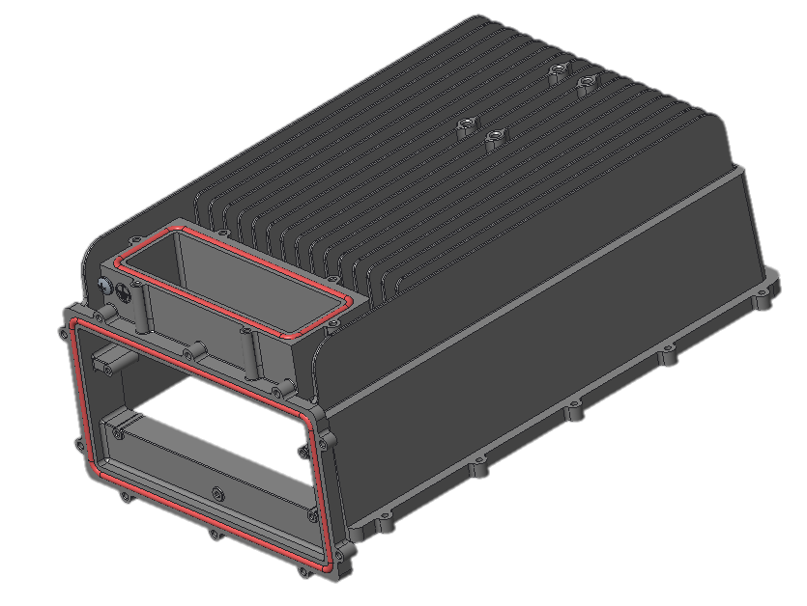
Main Chassis Sub Assembly
1.2
Main chassis Gasket
Battery cover Gasket
Front cover Gasket
Mechanics Chassis Sub Assembly Sequence
Sequence | Assembly steps | Type of Assembly
1.2 | Assemble Gaskets at 3 places as shown in above image 1. Main chassis gasket, 2. Front cover gasket & 3. Battery cover gasket Note: Gasket material B017XS7395-60 from Parker or Equivalent | Factory Assembly

Slide 6
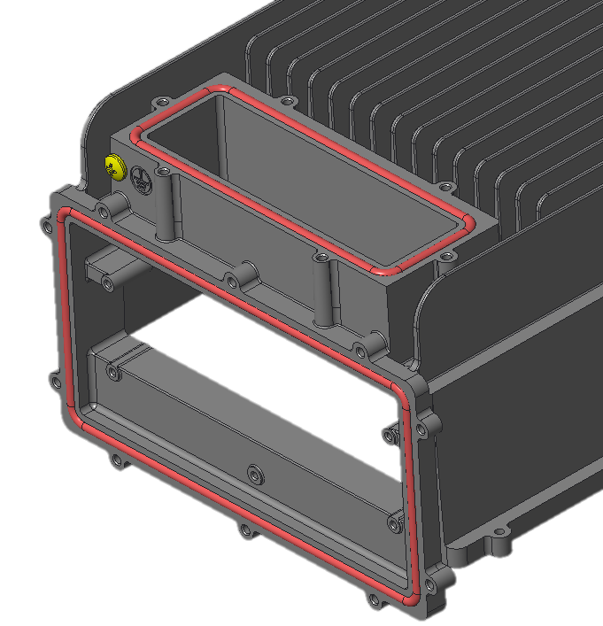
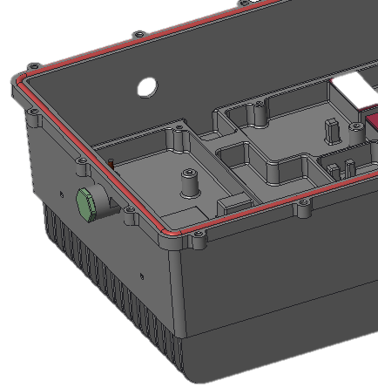
Main Chassis Sub Assembly
1.3
1.4
92005A320
Moist Vent
Mechanics Chassis Sub Assembly Sequence
Sequence | Assembly steps | Type of Assembly
1.3 | Assemble Moist Vent (PMF100320 black) with torque of 0.7 +/- 0.1 Nm | Factory Assembly
1.4 | Assemble Grounding screw M5x10 (OpenCellular Part number 92005A320) hand tightened | Factory Assembly

Slide 7
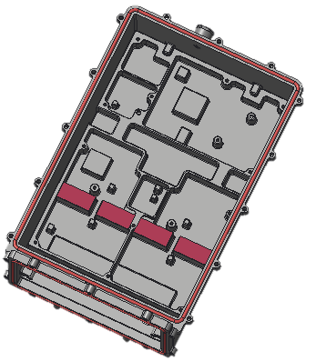
Main Chassis Sub Assembly
1.5
TIM
Mechanics Chassis Sub Assembly Sequence
Sequence | Assembly steps | Type of Assembly
1.5 | Assemble TIM (PG80A-00-150BL Fujipoly make) at 4 places as shown in above image | Factory Assembly

Slide 8
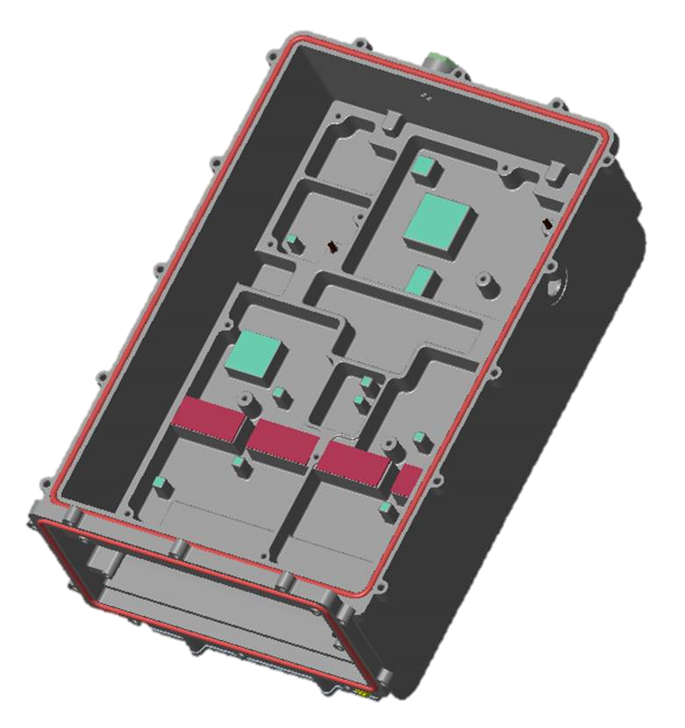
Main Chassis Sub Assembly
1.6
Thermal Gel
Mechanics Chassis Sub Assembly Sequence
Sequence | Assembly steps | Type of Assembly
1.6 | Dispense Thermal Gel as shown in the above image (location of thermal gel are marked in Cyan color) Note: For detailed Thermal gel dispensing instruction refer drawing 291-000017 | Factory Assembly

Slide 9
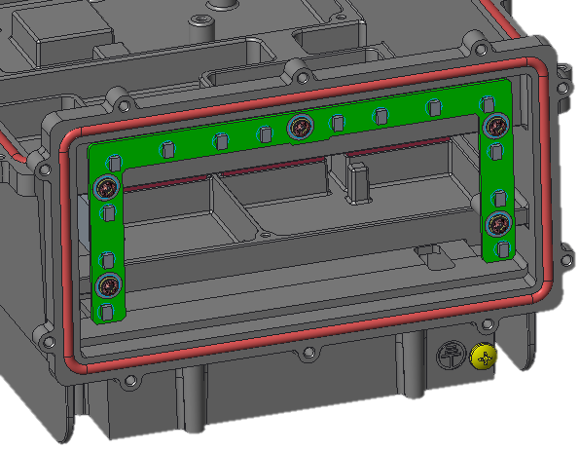
Main Chassis Sub Assembly
1.7
LED PCBA
Screw & Washer
Mechanics Chassis Sub Assembly Sequence
Sequence | Assembly steps | Type of Assembly
1.7 | Assemble LED PCB with M3x6 Screw & M3 washer at 5 places with torque of 1Nm | Factory Assembly

Slide 10
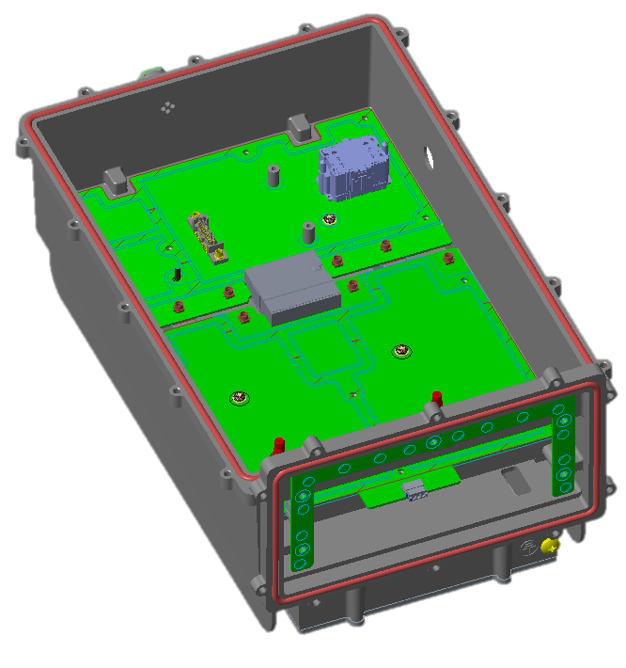
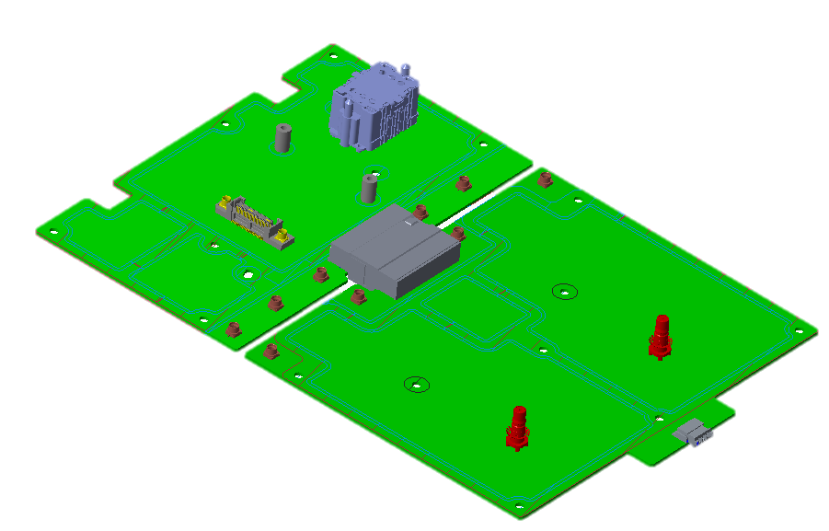
Main Chassis Sub Assembly
1.8.a
1.8.b
Mechanics Chassis Sub Assembly Sequence
Sequence | Assembly steps | Type of Assembly
1.8 | Assemble RF Front end & RF SDR boards together & place it in the main chassis using guide pins for locating Assemble M3x6 screw 3 no's and M3 flat washers as shown (marked inside red circle) in the above image with torque of 1Nm | Factory Assembly

Slide 11
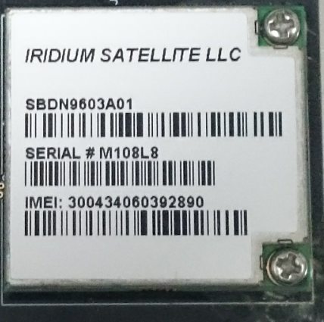
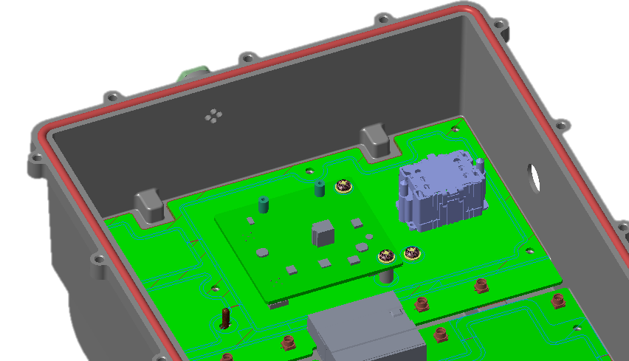
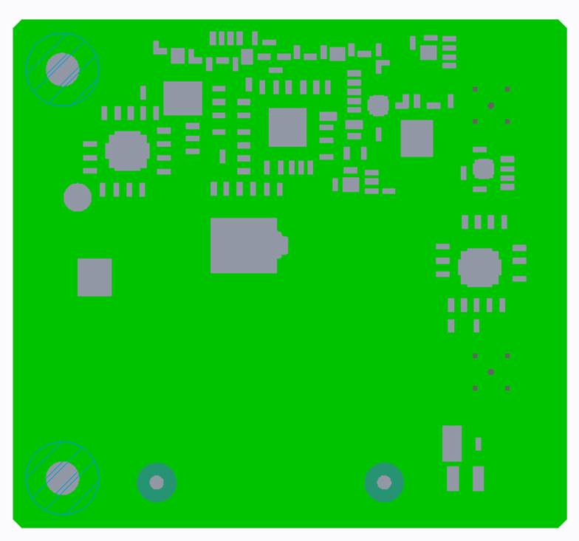
Main Chassis Sub Assembly
1.9
1.10
Iridium module
Sync Board
Iridium module
Mechanics Chassis Sub Assembly Sequence
Sequence | Assembly steps | Type of Assembly
1.9 | Assemble Iridium module on to Sync board & ensure to fix firmly with M2x4 screw 2 places | Factory Assembly
1.10 | Align Sync board on to RF SDR board & fix the board firmly with M3x6 screw 2 places and M3 flat washers as shown in the above image (Marked in red circle) with torque of 1Nm | Factory Assembly

Slide 12
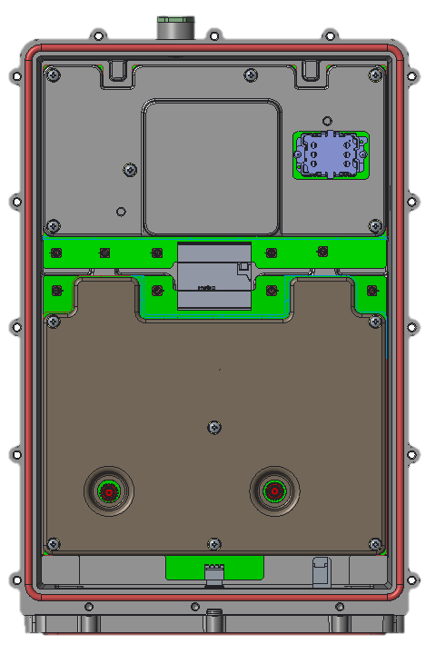
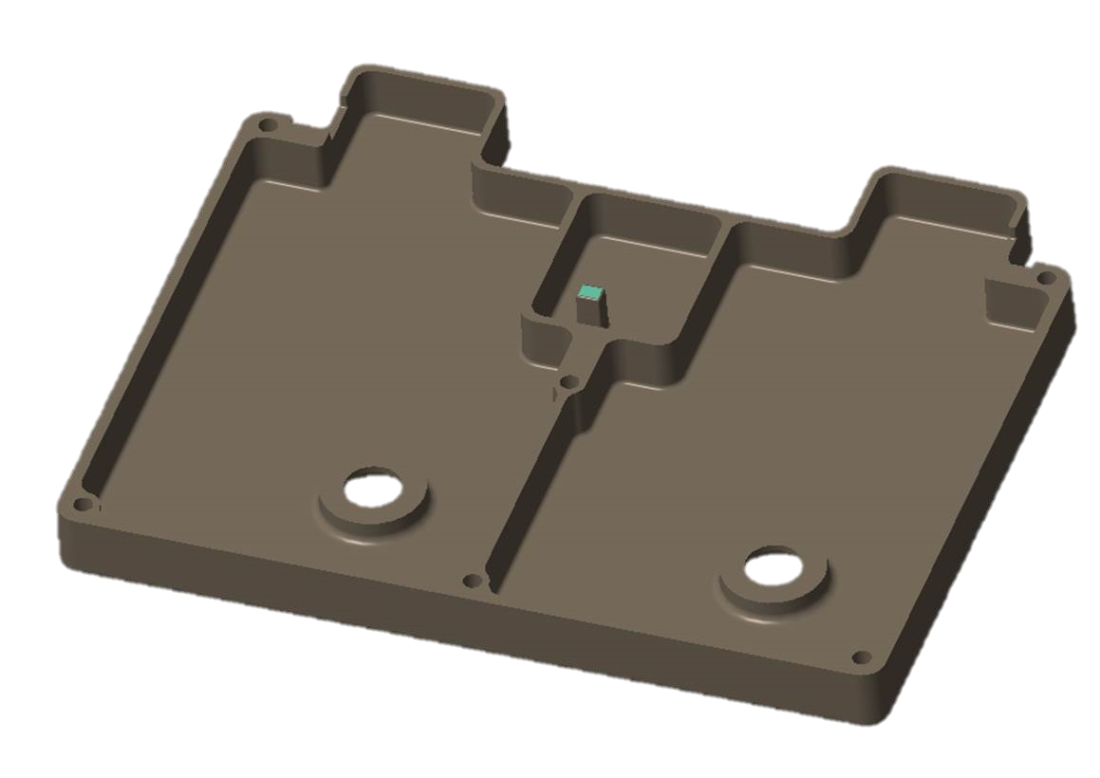
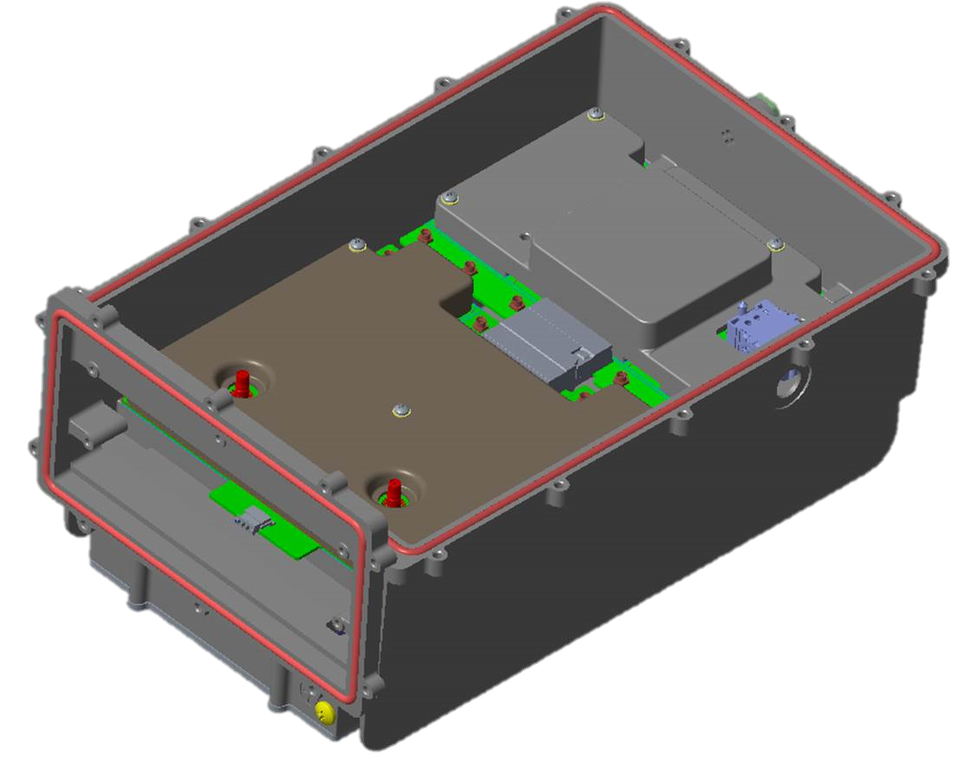
Main Chassis Sub Assembly
1.11
1.12.a
1.12.b
RF SDR Heat spreader plate
RF FE Heat spreader plate
RF FE Heat spreader plate
Mechanics Chassis Sub Assembly Sequence
Sequence | Assembly steps | Type of Assembly
1.11 | Dispense Thermal Gel for RF FE Heat spreader plate as shown in the above image (location of thermal gel are marked in Cyan color) Note: For detailed Thermal gel dispensing instruction refer drawing 291-000019 | Factory Assembly
1.12 | Assemble Heat spreader plates on top of RF Front end & RF SDR boards Align the heat spreader plates and assemble M3x22 screw 12 no's and M3 flat washers as shown in the above image (Marked in red circle) with torque of 1Nm | Factory Assembly

Slide 13
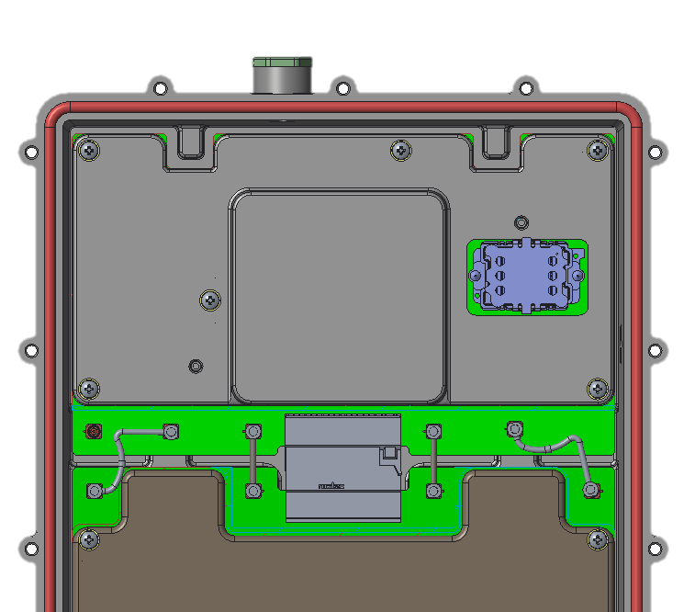
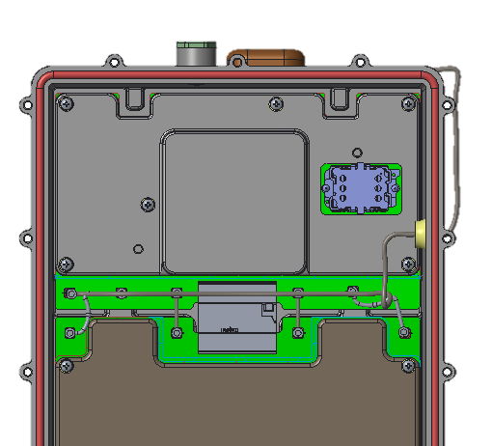
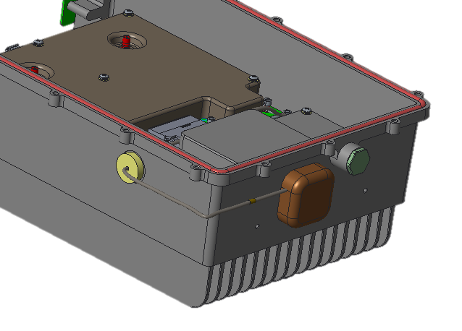
Main Chassis Sub Assembly
1.13
1.14
GPS Antenna cable assembly
GPS Antenna cable connector on RF SDR board
RF FE PCBA to RF SDR PCBA cable assembly
Mechanics Chassis Sub Assembly Sequence
Sequence | Assembly steps | Type of Assembly
1.13 | Assemble RF cable assembly – RF FE PCBA to RF SDR PCBA cable assembly 4 nos. as shown in above image | Factory Assembly
1.14 | Assemble GPS Antenna cable assembly (i.e., Stick GPS Antenna module at the location shown) & insert the connector inside the Grommet hole & connect to connector on RF SDR board as shown in above image | Factory Assembly

Slide 14
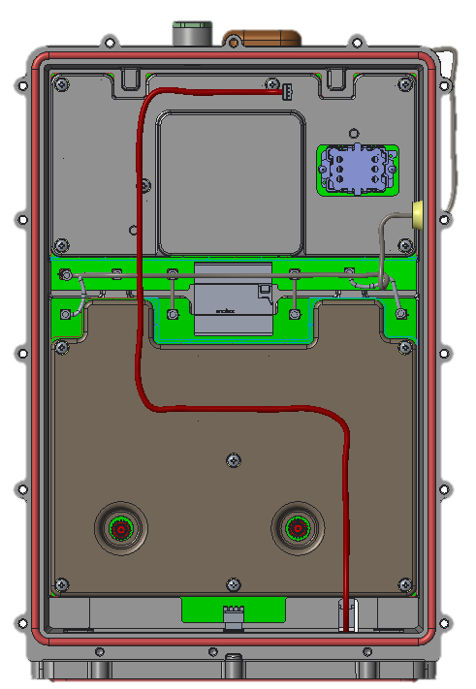
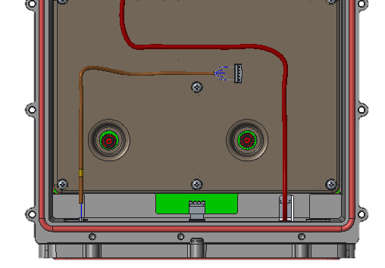
Main Chassis Sub Assembly
1.15
1.16
Mechanics Chassis Sub Assembly Sequence
Sequence | Assembly steps | Type of Assembly
1.15 | Route Battery cable assembly as shown in the above image & insert one end of cable into battery compartment as shown | Factory Assembly
1.16 | Connect LED Cable assembly in LED board and Route LED cable assembly as shown in image | Factory Assembly

Slide 15
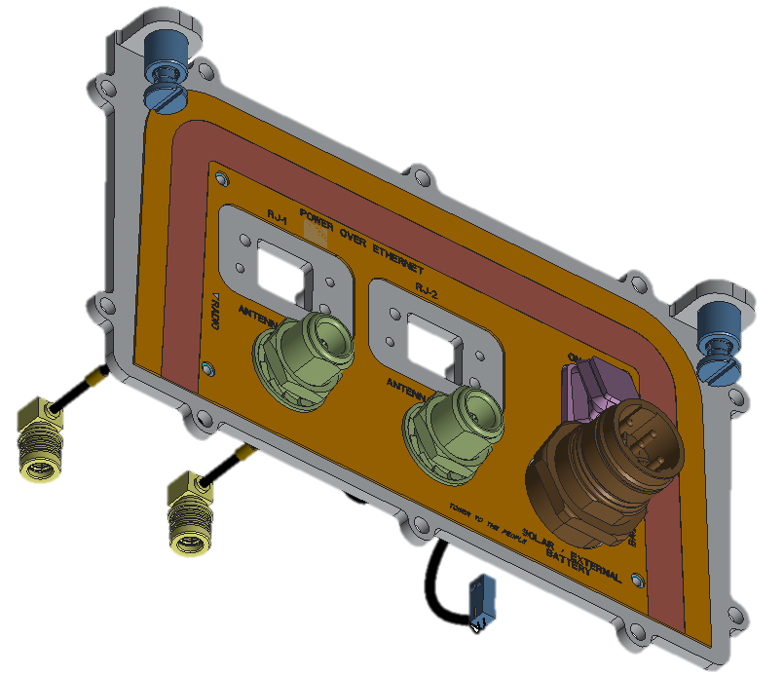
Front Cover Sub Assembly
2.0

Slide 16
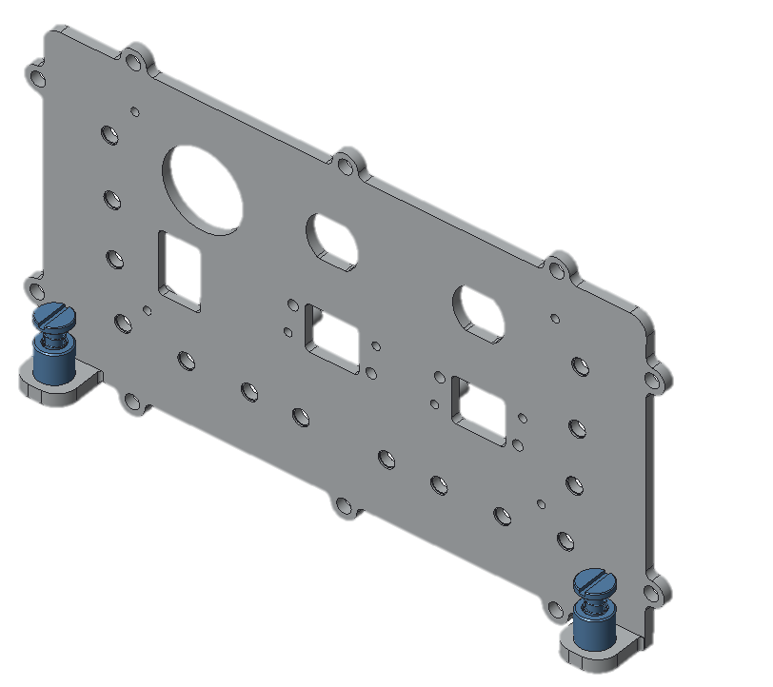
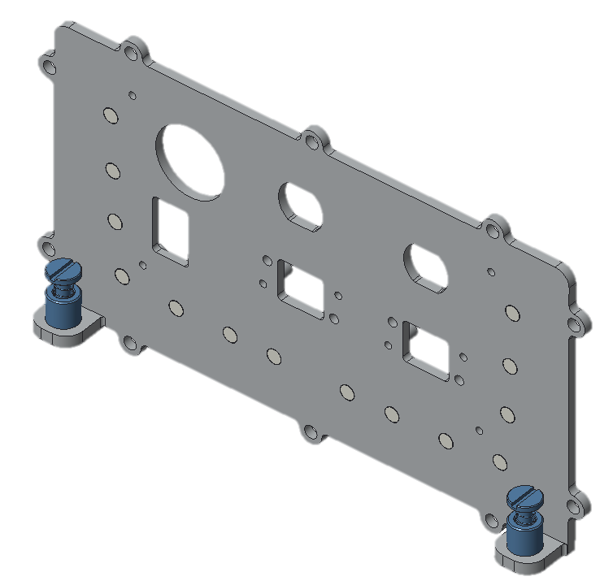
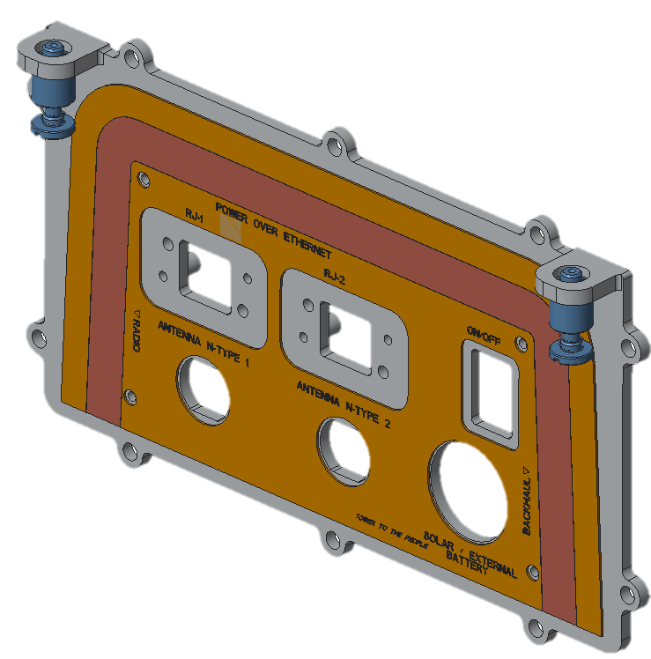
Front Cover Sub Assembly
2.1
Captive screw
LED Light pipe
Front overlay
Front Cover Sub Assembly Sequence
Sequence | Assembly steps | Type of Assembly
2.1 | Captive screw (PFC-2-M5-72) 2 no's , LED light pipe 14 no’s & overlay will be assembled by Front cover manufacturer | Pre – Assembly (Vendor Supplied)

Slide 17
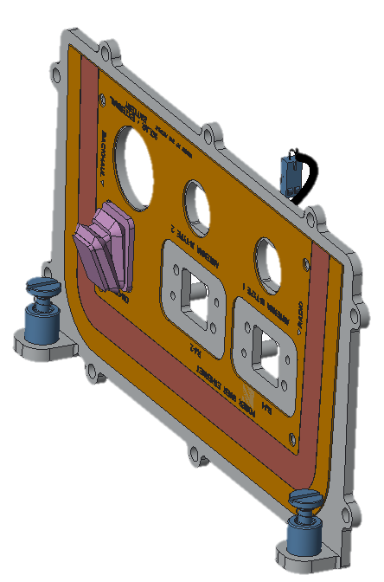
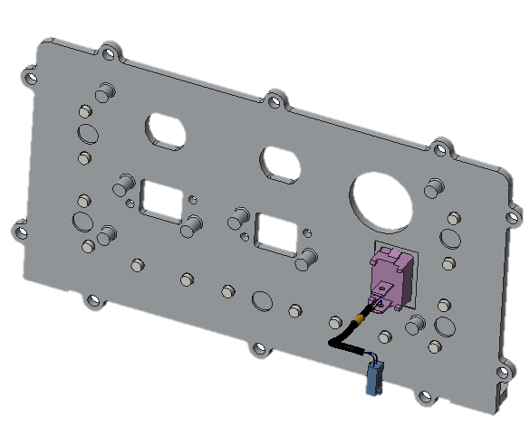
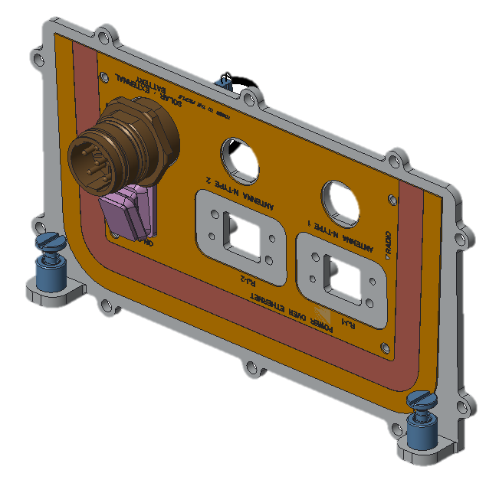
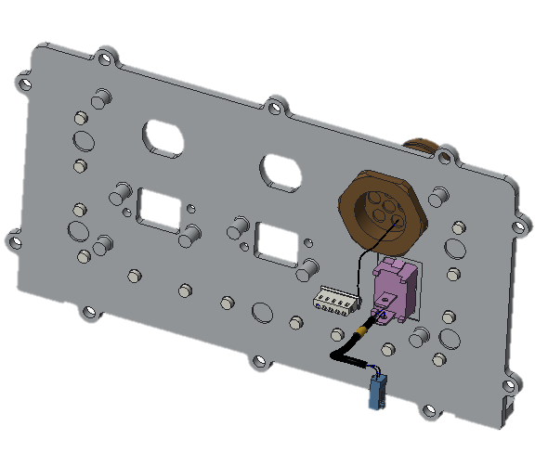
Front Cover Sub Assembly
2.2
2.3
Power Switch cable assembly
Power connector cable assembly
Front Cover Sub Assembly Sequence
Sequence | Assembly steps | Type of Assembly
2.2 | Assemble Power switch cable assembly (Press fit) at the location shown in the above image | Factory Assembly
2.3 | Assemble Power connector cable assembly at the location shown in the above image with torque of 5Nm | Factory Assembly

Slide 18
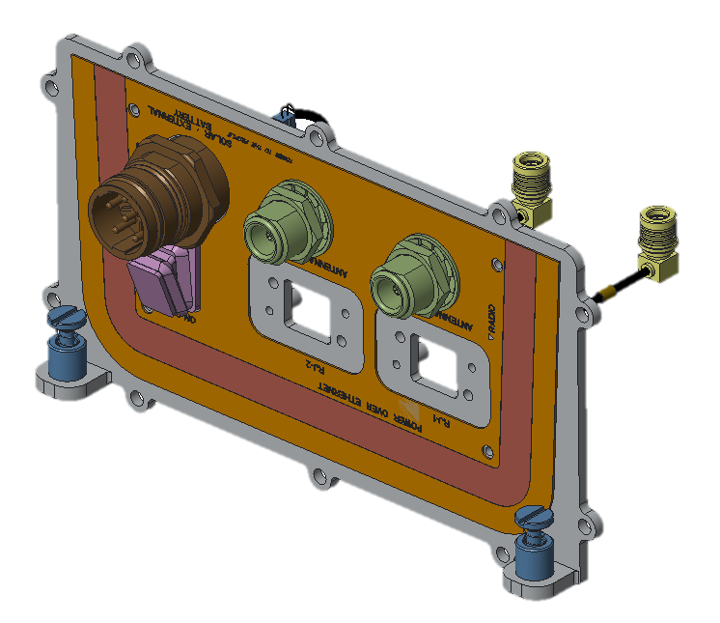
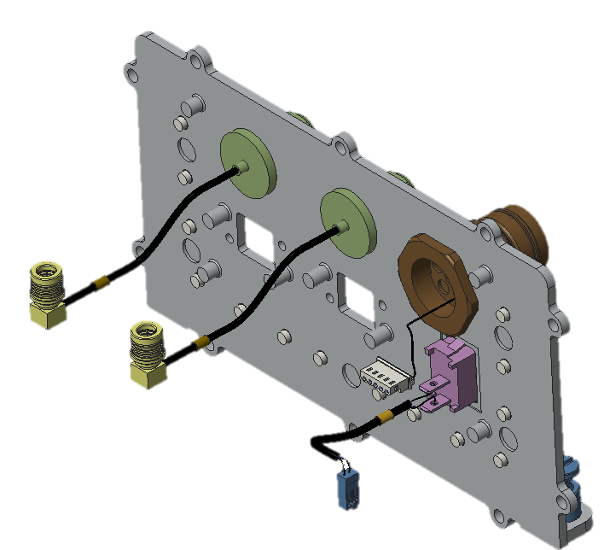
Front Cover Sub Assembly
2.4
Antenna Cable assembly
Front Cover Sub Assembly Sequence
Sequence | Assembly steps | Type of Assembly
2.4 | Assemble Antenna cable assembly at the location shown in the above image with torque of 0.7Nm to 1.1Nm | Factory Assembly

Slide 19
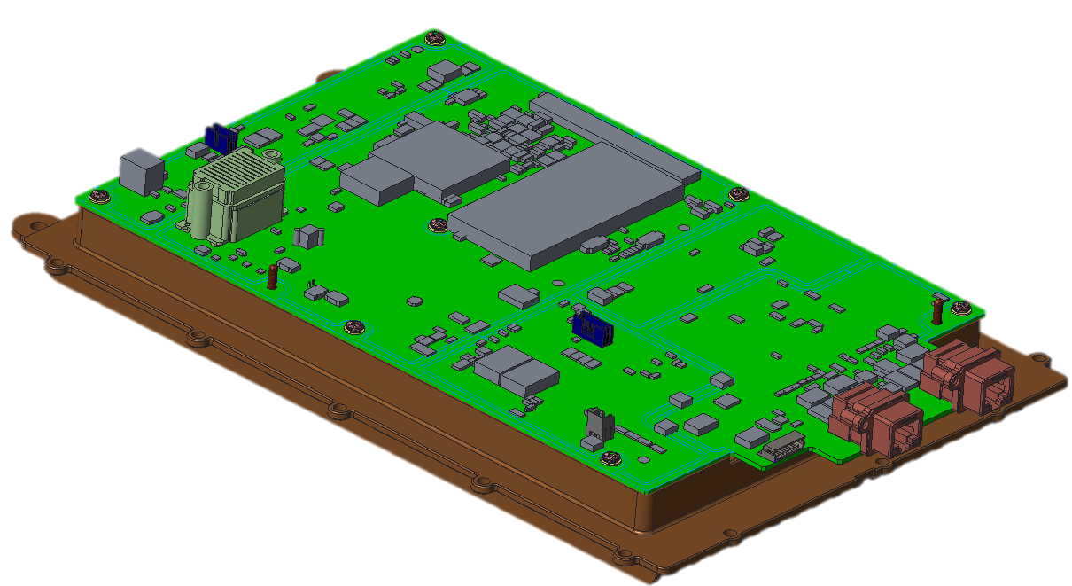
Top Cover Sub Assembly
3.0

Slide 20
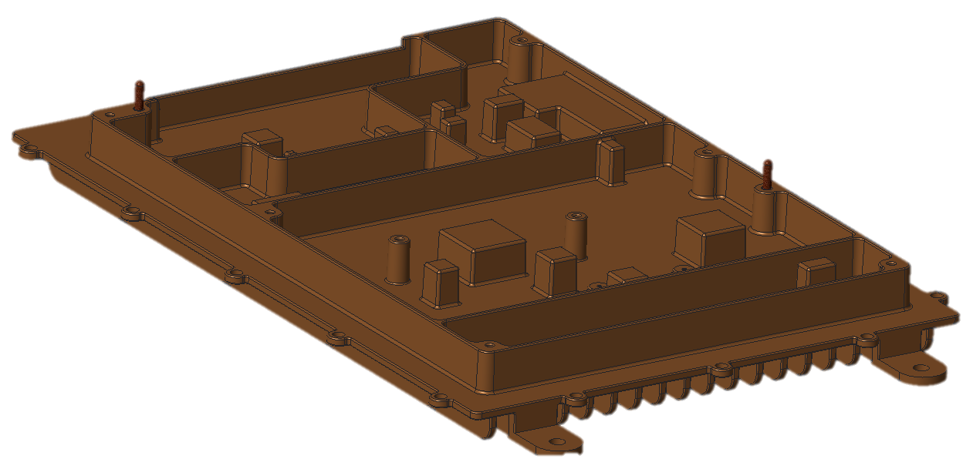
Top Cover Sub Assembly
3.1
Guide Pin
Front Cover Sub Assembly Sequence
Sequence | Assembly steps | Type of Assembly
3.1 | Guide pin (FPQSA4-P3.00-L4-B10 2nos.) would be assembled by chassis manufacturing vendor | Pre – Assembly (Vendor Supplied)

Slide 21
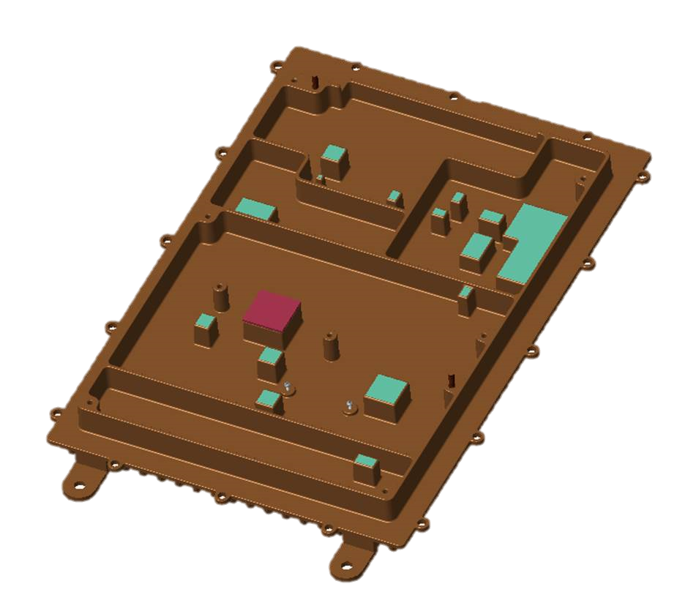
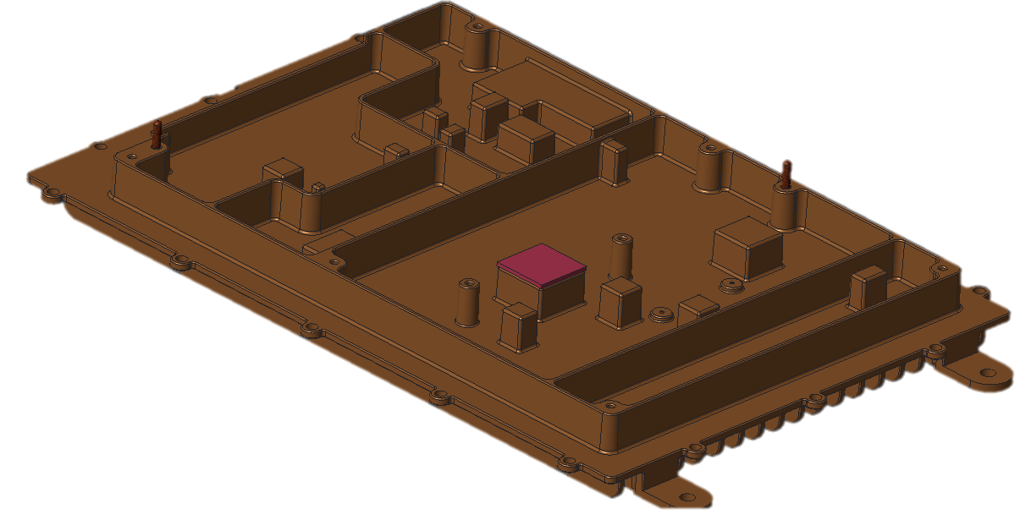
Top Cover Sub Assembly
3.2
3.3
TIM
Front Cover Sub Assembly Sequence
Sequence | Assembly steps | Type of Assembly
3.2 | a) Assemble TIM (PG80A-00-150BL Fujipoly make) at 1 place as shown in above image | Factory Assembly
3.3 | Dispense Thermal Gel as shown in the above image (location of thermal gel are marked in Cyan color) Note: For detailed Thermal gel dispensing instruction refer drawing 291-000018 | Factory Assembly

Slide 22
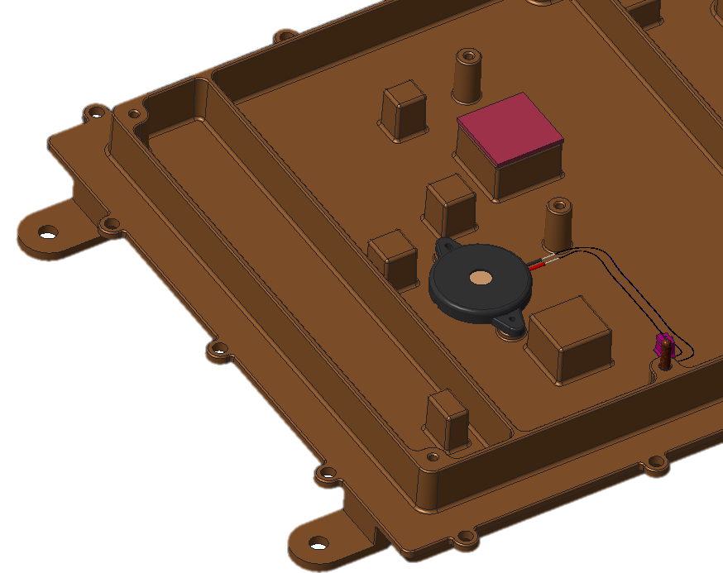
Top Cover Sub Assembly
3.4
Buzzer cable assembly
Front Cover Sub Assembly Sequence
Sequence | Assembly steps | Type of Assembly
3.4 | Assemble Buzzer cable assembly with M1.6x6 Screw 2 no's with torque of 1Nm as shown in above image | Factory Assembly

Slide 23
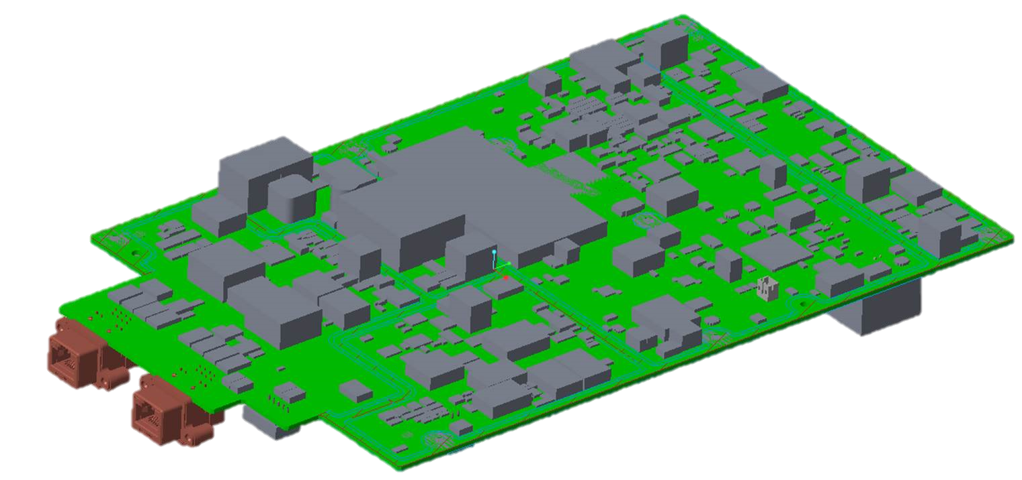
Top Cover Sub Assembly
3.5
Front Cover Sub Assembly Sequence
Sequence | Assembly steps | Type of Assembly
3.5 | Assemble SODIMM module on GBC board & ensure it is firmly fixed with auto latch | Factory Assembly

Slide 24
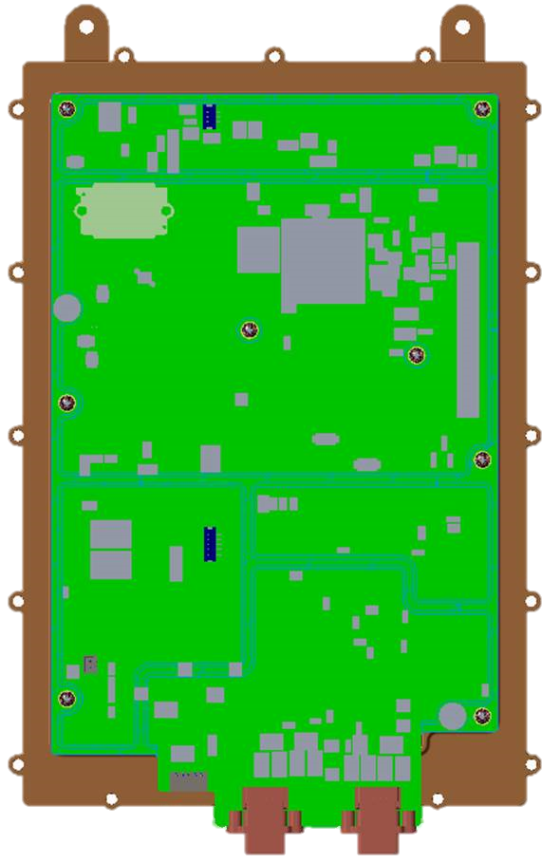
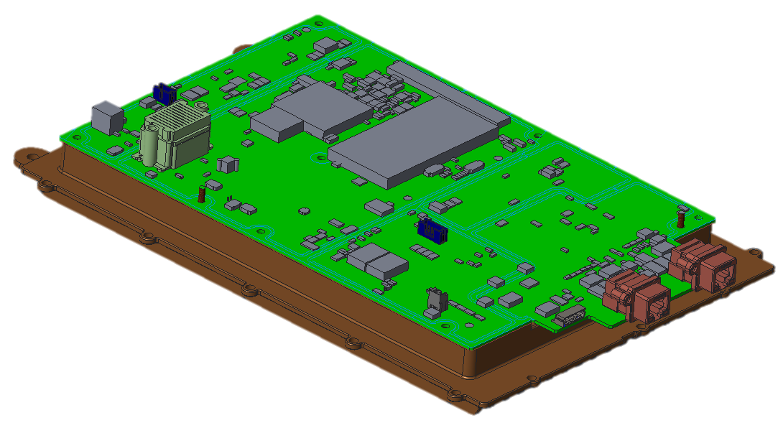
Top Cover Sub Assembly
3.6
3.7
Front Cover Sub Assembly Sequence
Sequence | Assembly steps | Type of Assembly
3.6 | Before placing GBC board on to Top cover connect buzzer cable assembly to its respective connector on GBC board | Factory Assembly
3.7 | Align GBC board with guide pins on top cover & assemble screws M3x6 Screw 8 nos. as shown in the above image (Marked in red circle) | Factory Assembly

Slide 25
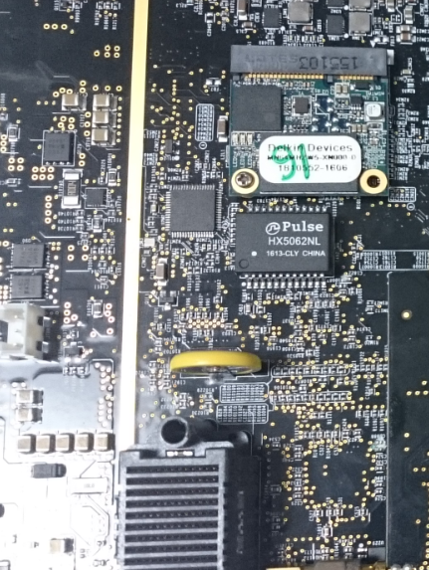
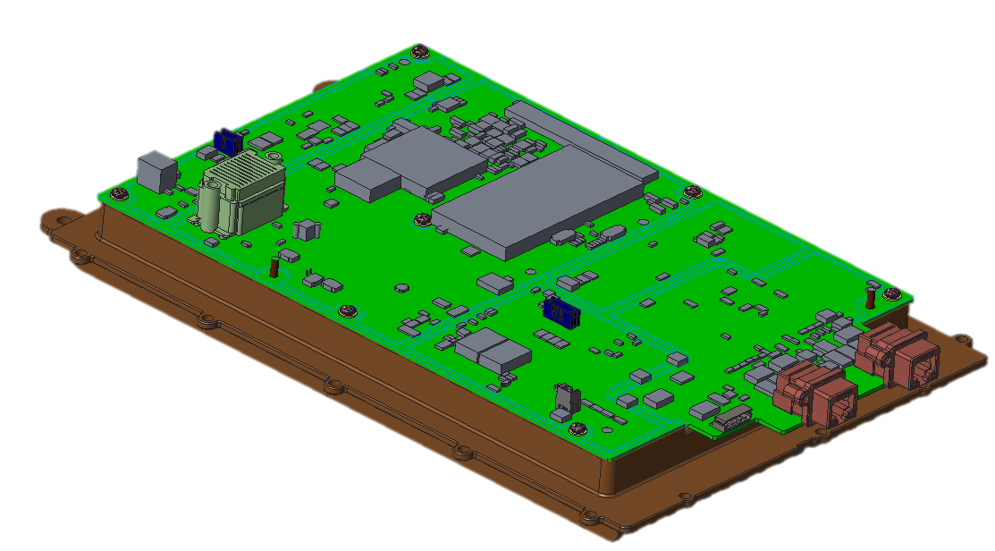
Top Cover Sub Assembly
3.8
This image is only for reference
Front Cover Sub Assembly Sequence
Sequence | Assembly steps | Type of Assembly
3.8 | Assemble mSATA at its respective position of connector & fix it firmly with M2x4 screw 1 nos. | Factory Assembly

Slide 26
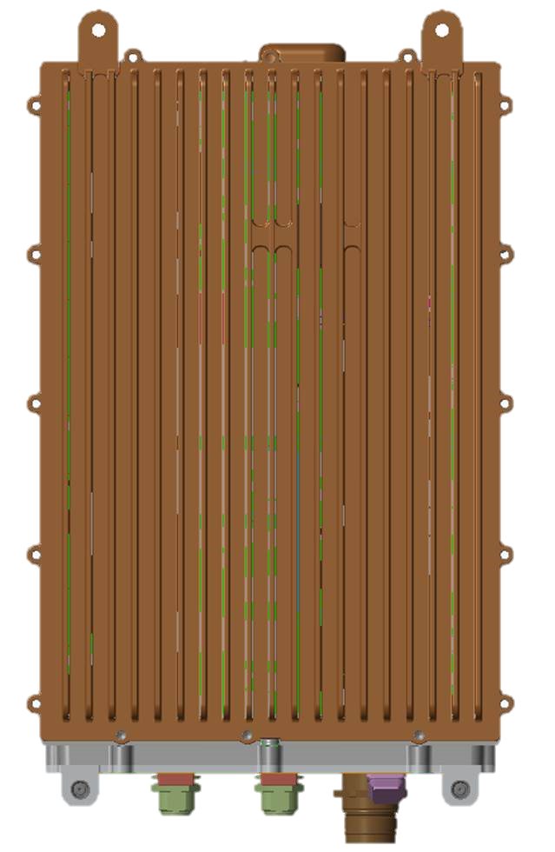
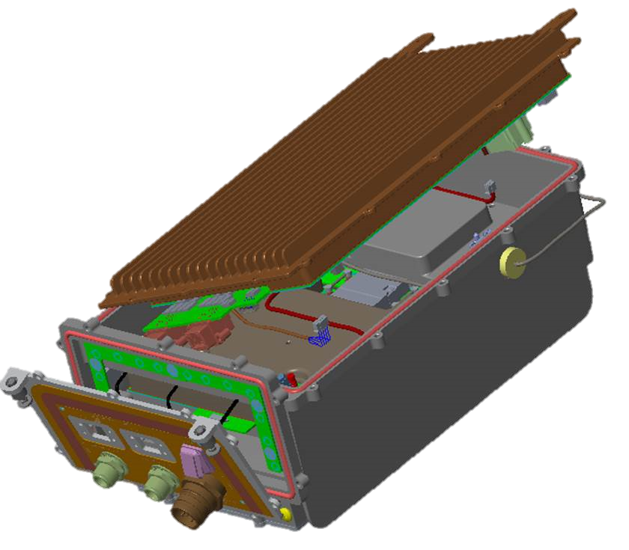
Main Chassis Assembly
4.1
4.1
Front Cover Sub Assembly Sequence
Sequence | Assembly steps | Type of Assembly
4.1 | Before assembling top cover on to Main chassis ensure to connect Batter cable assembly to GBC board Power switch cable assembly to GBC board LED Cable assembly to GBC board Power connector cable assembly to GBC board Antenna cable assembly to RF FE board | Factory Assembly
4.2 | Align Top cover & Main chassis assembly to their respective screw points & fix it firmly with M4x 10 screws 16 no’s with torque of 2.2 Nm | Factory Assembly

Slide 27
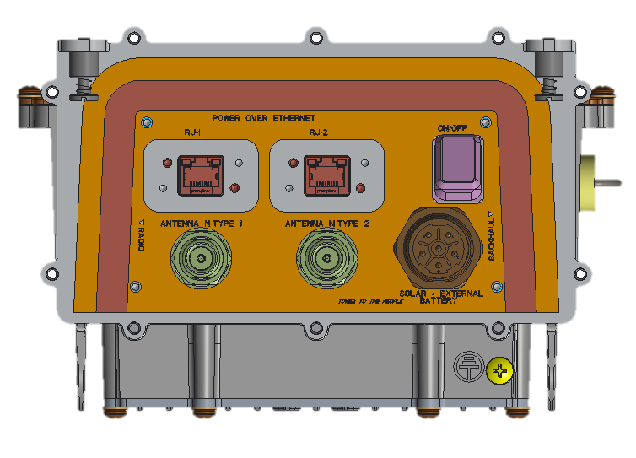
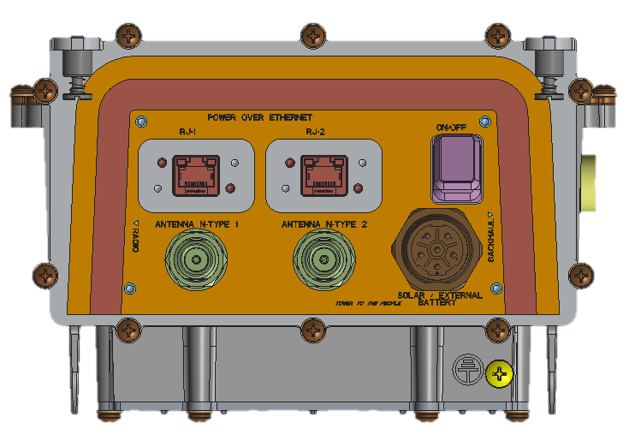
Main Chassis Assembly
4.3
Front Cover Sub Assembly Sequence
Sequence | Assembly steps | Type of Assembly
4.3 | Align Front cover assembly on to Main chassis sub assembly & fix it firmly with M4x10 screw with torque of 2.2Nm as shown in above image (Marked in red circle) | Factory Assembly

Slide 28
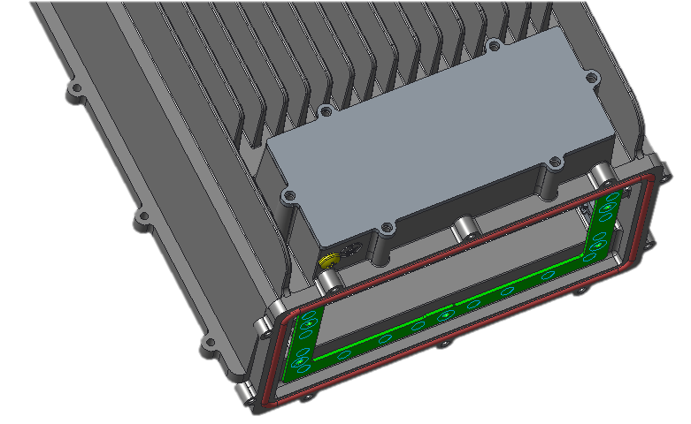
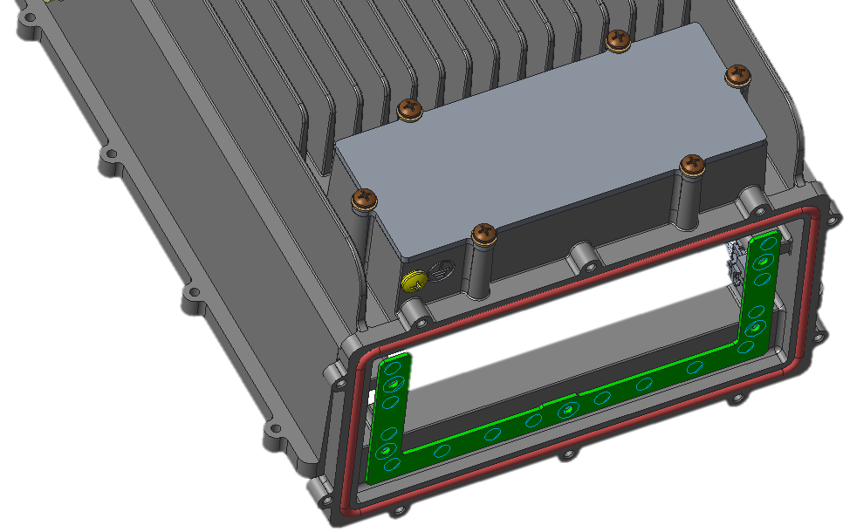
Main Chassis Assembly
4.4
Front Cover Sub Assembly Sequence
Sequence | Assembly steps | Type of Assembly
4.8 | Align battery cover & fix it firmly with M4x10 screws 6 nos. | Factory Assembly

Slide 29
Battery Assembly
Battery has to be assembled inside the unit during the field installation stage
Battery placed inside battery compartment
Foam wrapped on top of battery
Remove Battery cover from its place
Battery should be wrapped with foam & placed inside battery slot, before placing inside battery slot connectors need to be ensured to plugged
Reassemble Battery cover in its own place and assemble with the M4x6 screws with proper torque

Slide 30
Main Chassis Assembly
4.5
Light pipe
Front Cover Sub Assembly Sequence
Sequence | Assembly steps | Type of Assembly
4.5 | Align light pipe part on to front cover and fix it with 4 nos. of M3x6 screw as shown in above image (Marked in red circle) with torque of 1Nm | Factory Assembly

Slide 31
Main Chassis Assembly
4.6
Shorty Antenna
Front Cover Sub Assembly Sequence
Sequence | Assembly steps | Type of Assembly
4.6 | Align Shorty antenna plastic part and assemble the part with M3x6 screw with torque of 1 Nm | Factory Assembly

Slide 32
Main Chassis Assembly
4.7
Front Cover Sub Assembly Sequence
Sequence | Assembly steps | Type of Assembly
4.7 | Place the Main chassis assembly inside Front visual cover as shown & assemble 2 nos. of M4x10 screws & M3x6 screws 2 no’s at the location as shown. Assemble captive screws & M4x10 screw with torque of 2.2 Nm | Factory Assembly

Slide 33
Main Chassis Assembly
4.8
Front Cover Sub Assembly Sequence
Sequence | Assembly steps | Type of Assembly
4.8 | Align Pole mounting bracket at the rear side of mechanics as shown & assemble 4 nos. of M5x10 Screw with torque of 4.5Nm | Factory Assembly

Slide 34
Pole mounting instructions
Pole clamp assembly
Wedge
Pole clamp assembly first needs to be assembled to pole & then the unit with pole mounting bracket needs to be dropped & Wedge to be properly placed & tightened with screw

